Slide 1

Welcome to this Lecture:
Text File I/O
The session will start shortly…
Questions? Drop them in the chat.
We'll have dedicated moderators answering questions.

Slide 2


Text File IO
September 2024

Slide 3

Software Engineering Session Housekeeping
The use of disrespectful language is prohibited in the questions, this is a supportive, learning environment for all - please engage accordingly. (Fundamental British Values: Mutual Respect and Tolerance)
No question is daft or silly - ask them!
There are Q&A sessions midway and at the end of the session, should you wish to ask any follow-up questions. Moderators are going to be answering questions as the session progresses as well.
If you have any questions outside of this lecture, or that are not answered during this lecture, please do submit these for upcoming Academic Sessions. You can submit these questions here: Questions

Slide 4
Software Engineering Session Housekeeping cont.
For all non-academic questions, please submit a query: www.hyperiondev.com/support
Report a safeguarding incident: www.hyperiondev.com/safeguardreporting
We would love your feedback on lectures: Feedback on Lectures

Slide 5
Skills Bootcamp
Progression Overview
To be eligible for a certificate of completion, students must fulfil three specific criteria. These criteria ensure a high standard of achievement and alignment with the requirements for the successful completion of a Skills Bootcamp.
✅ Criterion 1 - Meeting Initial Requirements
Criterion 1 involves specific achievements within the first two weeks of the program. To meet this criterion, students need to:
Attend a minimum of 7-8 hours per week of guided learning (lectures, workshops, or mentor calls) within the initial two-week period, for a total minimum of 15 guided learning hours (GLH), by no later than 15 September 2024.
Successfully complete the Initial Assessment by the end of the first 14 days, by no later than 15 September 2024.
Notes:
Graduation from the Skills Boot Camp requires fulfilling four criteria: initial requirements within the first two weeks, mid-course progress by week 4, course progress at the end, and demonstrating employability post-graduation. In order to successfully graduate from the Skills Bootcamp, you'll need to meet four key criteria. The first criterion, covering the initial requirements, must be fulfilled within the first two weeks of the program. This includes a minimum of 15 guided learning hours and the completion of your first four tasks.
The second criterion for mid-course progress has a deadline by week 8, where you are expected to complete a specific number of tasks depending on your track - 60 GLH & 13 Tasks

Slide 6
Skills Bootcamp
Progression Overview
✅ Criterion 2 - Demonstrating Mid-Course Progress
Criterion 2 involves demonstrating meaningful progress through the successful completion of tasks within the first half of the bootcamp. To meet this criterion, students should:
Complete 42 guided learning hours and the first half of the assigned tasks by the end of week 7, no later than 20 October 2024.
Notes:
Graduation from the Skills Boot Camp requires fulfilling four criteria: initial requirements within the first two weeks, mid-course progress by week 4, course progress at the end, and demonstrating employability post-graduation. In order to successfully graduate from the Skills Bootcamp, you'll need to meet four key criteria. The first criterion, covering the initial requirements, must be fulfilled within the first two weeks of the program. This includes a minimum of 15 guided learning hours and the completion of your first four tasks.
The second criterion for mid-course progress has a deadline by week 8, where you are expected to complete a specific number of tasks depending on your track - 60 GLH & 13 Tasks

Slide 7
Skills Bootcamp
Progression Overview
✅ Criterion 3 - Demonstrating Post-Course Progress
Criterion 3 involves showcasing students’ progress after completing the course. To meet this criterion, students should:
Complete all mandatory tasks before the bootcamp's end date. This includes any necessary resubmissions, no later than 22 December 2024.
Achieve at least 84 guided learning hours by the end of the bootcamp, 22 December 2024.
Notes:
Graduation from the Skills Boot Camp requires fulfilling four criteria: initial requirements within the first two weeks, mid-course progress by week 4, course progress at the end, and demonstrating employability post-graduation. In order to successfully graduate from the Skills Bootcamp, you'll need to meet four key criteria. The first criterion, covering the initial requirements, must be fulfilled within the first two weeks of the program. This includes a minimum of 15 guided learning hours and the completion of your first four tasks.
The second criterion for mid-course progress has a deadline by week 8, where you are expected to complete a specific number of tasks depending on your track - 60 GLH & 13 Tasks

Slide 8

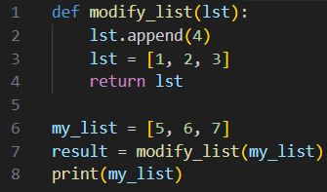
Poll
What is the output of the following code?
[5, 6, 7]
[1, 2, 3]
[5, 6, 7, 4, 1, 2, 3]
[5, 6, 7, 4]
Notes:
0
0
0
[5, 6, 7, 4]

Slide 9
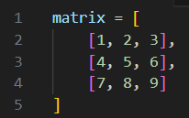
Poll
Given the following 2D list, what is the value of matrix[1][2]?
2
6
5
8
Notes:
0
6
0
0

Slide 10
Learning Objectives & Outcomes
Demonstrate the basics of file handling in Python, including opening, reading, writing, and closing files.
Perform common file operations such as reading from and writing to text files.
Handle file-related exceptions to ensure robust file operations.
Understand the importance of resource management in programming.
Use the 'with' statement to manage file resources efficiently, ensuring files are properly closed after operations.
Apply best practices for managing resources to prevent memory leaks and other resource-related issues.

Slide 11
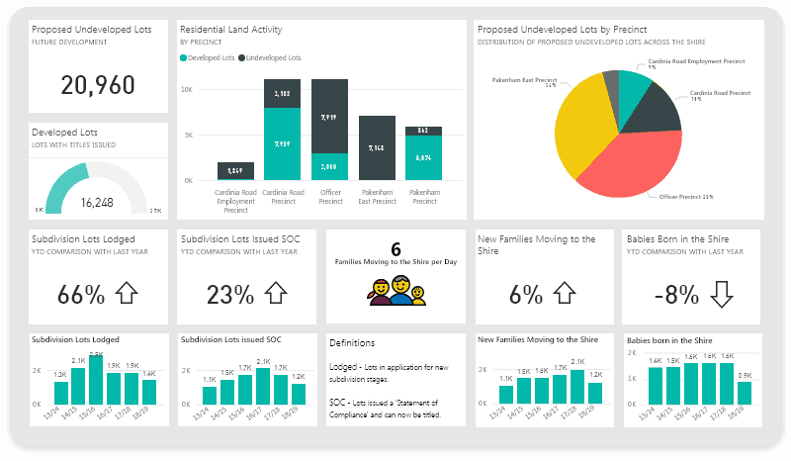



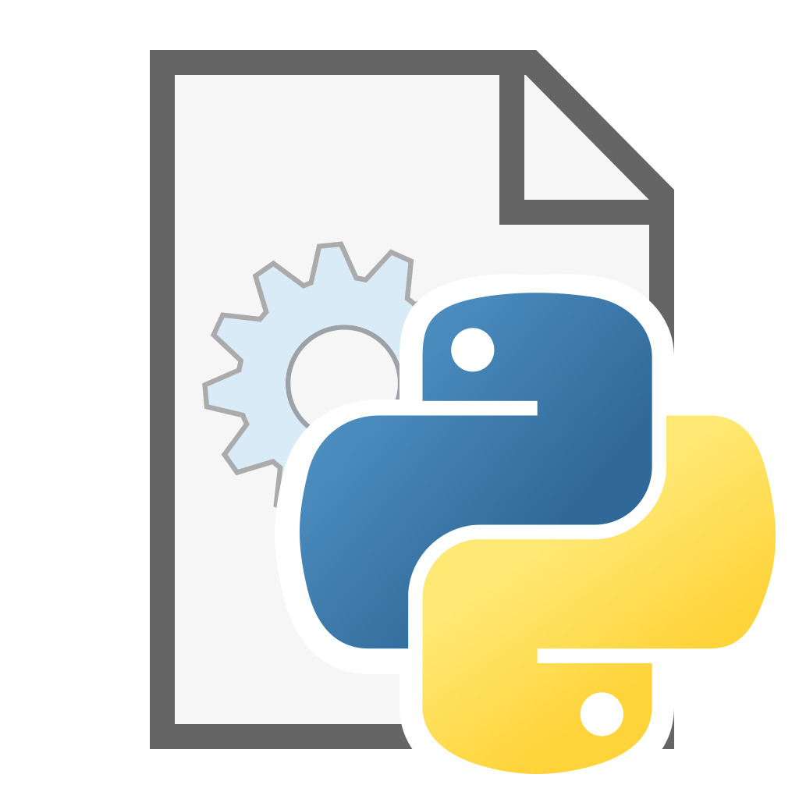




Introduction
Notes:
File I/O stands for Input/Output operations involving files.
It refers to the process of reading data from files (input) or writing data to files (output) using a computer program.
What exactly are external sources? places where your Python programs get data from or store data.
Why External sources?
Analytics: A retail company uses sales data from competitors (obtained through market research or public data) to analyze market trends, identify opportunities, and adjust pricing strategies accordingly.
Machine Learning: Airbus utilizes external data from various sources, such as weather conditions, airport altitudes, fuel quality, and aircraft age, to train a machine learning model that predicts engine maintenance needs. Another application could be the training of chatbots like Alexa, Siri.
Other processes:

Slide 12
What is File I/O ?
File I/O stands for Input/Output operations involving files.
It refers to the process of reading data from files (input) or writing data to files (output) using a computer program.
In simpler terms, file I/O is all about your program interacting with files: either taking in information from them or putting information into them. It's like the communication link between your program and the outside world of files

Slide 13



Understanding External Sources
They couldn’t play soccer because they couldn’t see the ball. They didn’t want to go inside and play a game because it was a beautiful springtime night and they liked being …[1]
id,name,price
1,Laptop,1200
2,Smartphone,800
3,Headphones,200
4,Mouse,50
5,Monitor, 1000
6,Desk,600
7,Speakers,400
{
"track_id": "3",
"name": "Inde",
"artist": "Bucie",
"album": "Inde",
"duration_ms": 373000,
"popularity": 3
}
[1] HIDE AND SEEK | Free Children's book from Monkey Pen
Notes:
Let's start with files. There are three main types of files we'll be working with:
Text files (.txt usually): These are the simplest kind of files. They contain plain text, like what you're seeing on this slide. You can use them to store any kind of text data.
A simple text document containing a list of names.
Corpus of Large Language Models (Training data for ChatGPT and the likes)
JSON files (.json): These are used for storing structured data. They're often used for configuration files and data exchange over the internet. JSON data is formatted as key-value pairs, making it easy to read and understand.
CSV files (.csv or tsv): These are used for storing tabular data. Think of them like spreadsheets. Each line in a CSV file represents a row of data, and commas separate the different values in each row.
A spreadsheet with sales data.
A dataset of customer information.
A file containing geographical coordinates.

Slide 14
File Manipulations
File modes in Python are specifications used when opening a file to indicate the intended operation that will be performed on the file. These modes determine whether the file will be opened for reading, writing, appending, or for a combination of reading and writing
File handling in Python refers to the process of working with files on your computer's storage. It allows you to read from, write to, and manipulate files. Python provides built-in functions and methods for performing various file operations.

Slide 15
File Handling
In Python, file I/O operations are performed using the open() function and various methods associated with file objects.
Opening Files: The open() function is used to open a file and returns a file object. You specify the file name/path and the mode in which you want to open the file ('r' for reading, 'w' for writing, 'a' for appending, etc.).

Slide 16
Working with Files in Python: I/O
file = open(“filename.txt”, “access_mode”)
content = file.read()
file.close()
Read Only | r
Read and Write | r+
Write Only | w
Write and Read | w+
Append Only | a
Append and Read | a+
opening
closing
Must be closed to avoid issues like memory leaks
Text file (.txt)
File Access Modes
Notes:
Read Only (‘r’) : Open text file for reading. The handle is positioned at the beginning of the file. If the file does not exist, raises the I/O error. This is also the default mode in which a file is opened.
Read and Write (‘r+’): Open the file for reading and writing. The handle is positioned at the beginning of the file. Raises I/O error if the file does not exist.
Write Only (‘w’) : Open the file for writing. For the existing files, the data is truncated and over-written. The handle is positioned at the beginning of the file. Creates the file if the file does not exist.
Write and Read ('w+') : Open the file for reading and writing. For an existing file, data is truncated and over-written. The handle is positioned at the beginning of the file
Append Only ('a'): Opens a file for writing, adding new content to the end of the existing data.
Append and Read ('a+'): Opens a file for both reading and writing, allowing you to read existing content and add new data to the end of the file.
read(): Reads the entire content of a file as a single string, making it useful when you need to work with all the text at once.
readlines(): Reads all lines of a file and returns them as a list of strings, making it ideal for processing each line separately.
Why closing:
Closing a file in Python is just as important as opening it. When a file is closed, Python frees up the system resources that were used during the file operation. If a file is not properly closed, it can lead to memory leaks, which can slow down your program or even cause it to crash..

Slide 17
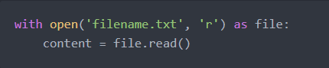
Resource Management: Implicit Method
The with statement is used for resource management in Python.
It ensures that resources are properly cleaned up after use, even if an error occurs.

Slide 18
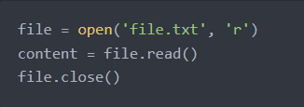
Resource Management: Explicit Method
The explicit way involves manually opening and closing files using the open() function for opening and the close() method for closing.

Slide 19
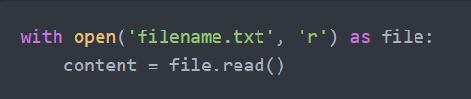
File Access Modes (r)
Reading from Text Files: You can read text from a file using the open() function with the mode 'r'

Slide 20
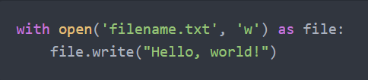
File Access Modes (w)
Writing to Text Files: You can write text to a file using the open() function with the mode 'w'

Slide 21
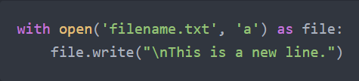
File Access Modes (a)
Appending to Text Files: You can append text to an existing file using the open() function with the mode 'a'

Slide 22
File Handling (Reading)
Read from a File Python
Methods
read()
Reads the entire contents of the file and returns it as a string.
readline()
Reads a single line from the file and returns it as a string.
readlines()
Reads all lines from the file and returns them as a list of strings.

Slide 23
File Handling (Writing)
Write to a File Python
Methods
write()
This method is used to write data to the file. It takes a string argument and adds it to the end of the file.
writelines()
This method writes a sequence of strings to the file. It takes a list of strings as an argument and writes each string to the file.

Slide 24
Let’s take a short Break

Slide 25
Exception Handling

Slide 26
Exception Handling
An Error/Exception is an unexpected event that interrupts the normal execution of a computer program, preventing it from achieving its intended outcome.
Exception handling in Python allows you to gracefully manage errors that may occur during program execution, including when working with files.

Slide 27
File Exception Handling
IsADirectoryError
with open("directory_name.txt", 'r') as file:
content = file.read()
FileNotFoundError
PermissionError
with open("filename.txt", 'r') as file:
content = file.read()
with open("filename.txt", 'w') as file:
content = file.read()
Notes:
All I/O interactions required exceptions or error handling to avoid issues while running the program
IsADirectoryError:
What is it:IsADirectoryError is a specific type of OSError in Python that occurs when a file operation is attempted on a directory.
Explanation:This error is raised when code tries to use a directory as if it were a regular file, typically when attempting to read from or write to a path that points to a directory instead of a file.
FileNotFoundError:
What is it:FileNotFoundError is a specific type of OSError in Python that occurs when an attempt is made to access a file that does not exist.
Explanation:This error is raised when trying to open, read from, or perform operations on a file that cannot be found in the specified path or directory.
PermissionError:
What is it:PermissionError is a specific type of OSError in Python that occurs when an operation is attempted without the necessary access rights.
Explanation:This error is raised when a program tries to perform an action on a file or directory that it doesn't have the appropriate permissions for, such as writing to a read-only file or accessing a restricted directory.

Slide 28
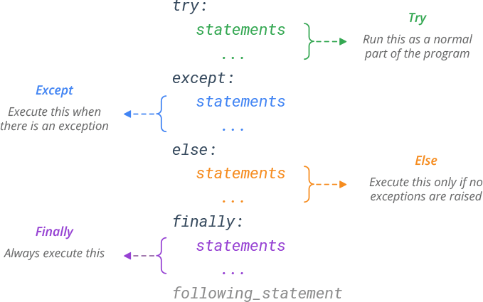
Try / Except / Finally Structure
Notes:
1. try
Purpose: Wraps a block of code that might raise an exception.
Usage: If an exception occurs in the try block, Python will move to the corresponding except block.
2. except
Purpose: Catches and handles exceptions.
Usage: Used to define the block of code that runs if an exception is raised in the try block.
3. else
Purpose: Executes a block of code if no exceptions are raised in the try block.
Usage: Placed after all except blocks.
4. finally
Purpose: Always executes a block of code, regardless of whether an exception occurred or not.
Usage: Often used for cleanup actions, like closing files or releasing resources.
5. raise
Purpose: Manually triggers an exception.
Usage: Used when you want to create a custom error or re-raise an existing one.

Slide 29
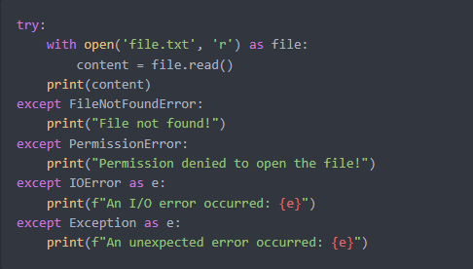
Try / Except Example
You can wrap file I/O operations inside a try block and catch specific exceptions using except blocks.

Slide 30
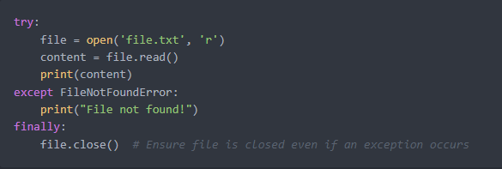
Try / Except / Finally
We can also use a finally block to ensure that certain cleanup actions are always performed, regardless of whether an exception occurred or not.

Slide 31
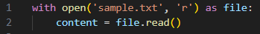
Poll
Given the following code, which lines ensure the file is properly closed after reading?
with open('sample.txt', 'r') as file:
content = file.read()
file.close()
The file is automatically closed when using 'with'
Notes:
with open('sample.txt', 'r') as file:
-
-
The file is automatically closed when using 'with'

Slide 32
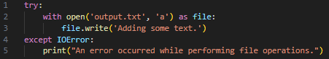
Poll
What is the output of the following code?
Creates a new file and writes 'Adding some text.' to it.
Always raises an IOError exception.
Appends 'Adding some text.' to output.txt.
Prints a message if there's an issue with file operations.
Notes:
-
-
Appends 'Adding some text.' to output.txt.
Prints a message if there's an issue with file operations.

Slide 33
Lesson Conclusion and Recap
File Operations
Open/close, read/write files (text, CSV, JSON)
File modes: read, write, append
open(), read(), write(), with statement
Working with External Data Formats
Handling text
Error Handling with Exceptions
Importance of error handling
Common exceptions: FileNotFoundError, PermissionError, IsADirectory
try, except, else, finally blocks

Slide 34
Follow-up Activity
Task Overview:
You will create a Python program that processes student grades stored in a text file. The program should read the grades, calculate the average, identify the highest and lowest grades, and write these results to a new text file.
Steps:
Create a Function to Read Data:
Write a function read_grades(filename) that reads grades from a text file, where each line contains a grade. Store these grades in a list.
Process the Data:
Write a function process_grades(grades) that:
Calculates the average grade from the provided ones
Identifies the highest and lowest grades from the provided ones
Returns these values.

Slide 35
Follow-up Activity
Write the Results to a New File:
Write a function write_results(filename, average, highest, lowest) that writes the average, highest, and lowest grades to a new text file.
Main Program:
Combine the functions in a main block:
Use read_grades to read the grades from a file named grades.txt.
Use process_grades to calculate the necessary statistics.
Use write_results to save the results in a file named results.txt.
Example Files:
Input File (grades.txt): 85
90
78
92
88
Output File (results.txt):
Average Grade: 86.6
Highest Grade: 92
Lowest Grade: 78

Slide 36
Follow-up Activity
Submission: Just make sure that you have the output provided above. This is not tied to any of your tasks.
Use any method available to you. As long as you understand the process.

Slide 37
Questions and
Answers

Slide 38

Thank you for attending

